Slide 1

Welcome
Piner Elementary School
Feb. 4, 2025

Slide 2
History of the Site Readiness Initiative
2014: Kenton County updated its comprehensive plan. The South Kenton County Citizens Group (SKCCG) was formed subsequent to that process.
2015 & 2016: The SKCCG surveyed Southern residents regarding the area’s future. In 2016, during a presentation to the Fiscal Court, SKCCG representatives shared 97% of respondents (roughly 850 residents) supported light and medium industrial development in the southwest end of Kenton County along the US 25/I-75 corridor.
2020: Comprehensive plan update included land use changes, specifically changing the western portion from agriculture to residential. SKCCG supported the change and provided a letter of support for the land use change.
2024: Kenton County underwent a comprehensive plan update where no land use changes pursued but a public meeting was held at Piner Baptist Church to seek feedback.

Slide 3
This Fiscal Court will not use eminent domain to acquire land for private development.

Slide 4
There are currently no rezoning proposals being considered for this initiative.

Slide 5
Each focus area has a limited number of locations suitable for industrial development on undeveloped land. However, the County aims to ensure all areas are properly considered to minimize potential impacts.

Slide 6
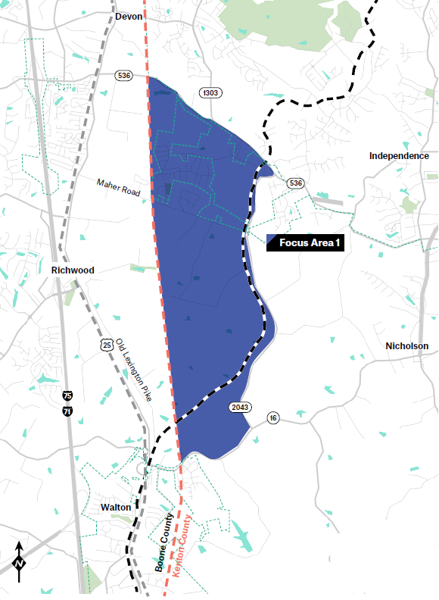
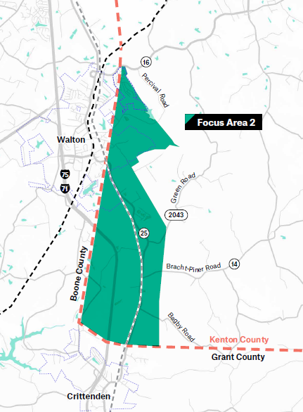
Key
Blue: Unlikely to see industrial development
Yellow: Current agriculture; potential industrial/residential
Pink: Current mixed-use
Gray: Already zoned for industrial (since 2008)
Orange: Recommended land use industrial (since 2020) & most likely for new industrial development
Purple: Recommended land use industrial
Green: Current (and recommended) agriculture
White: Preservation area

Slide 7
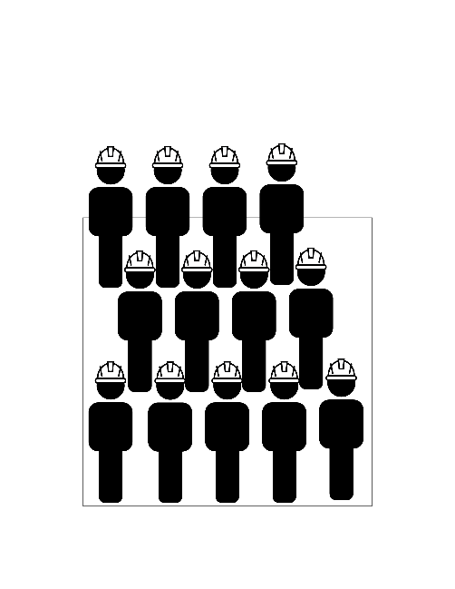
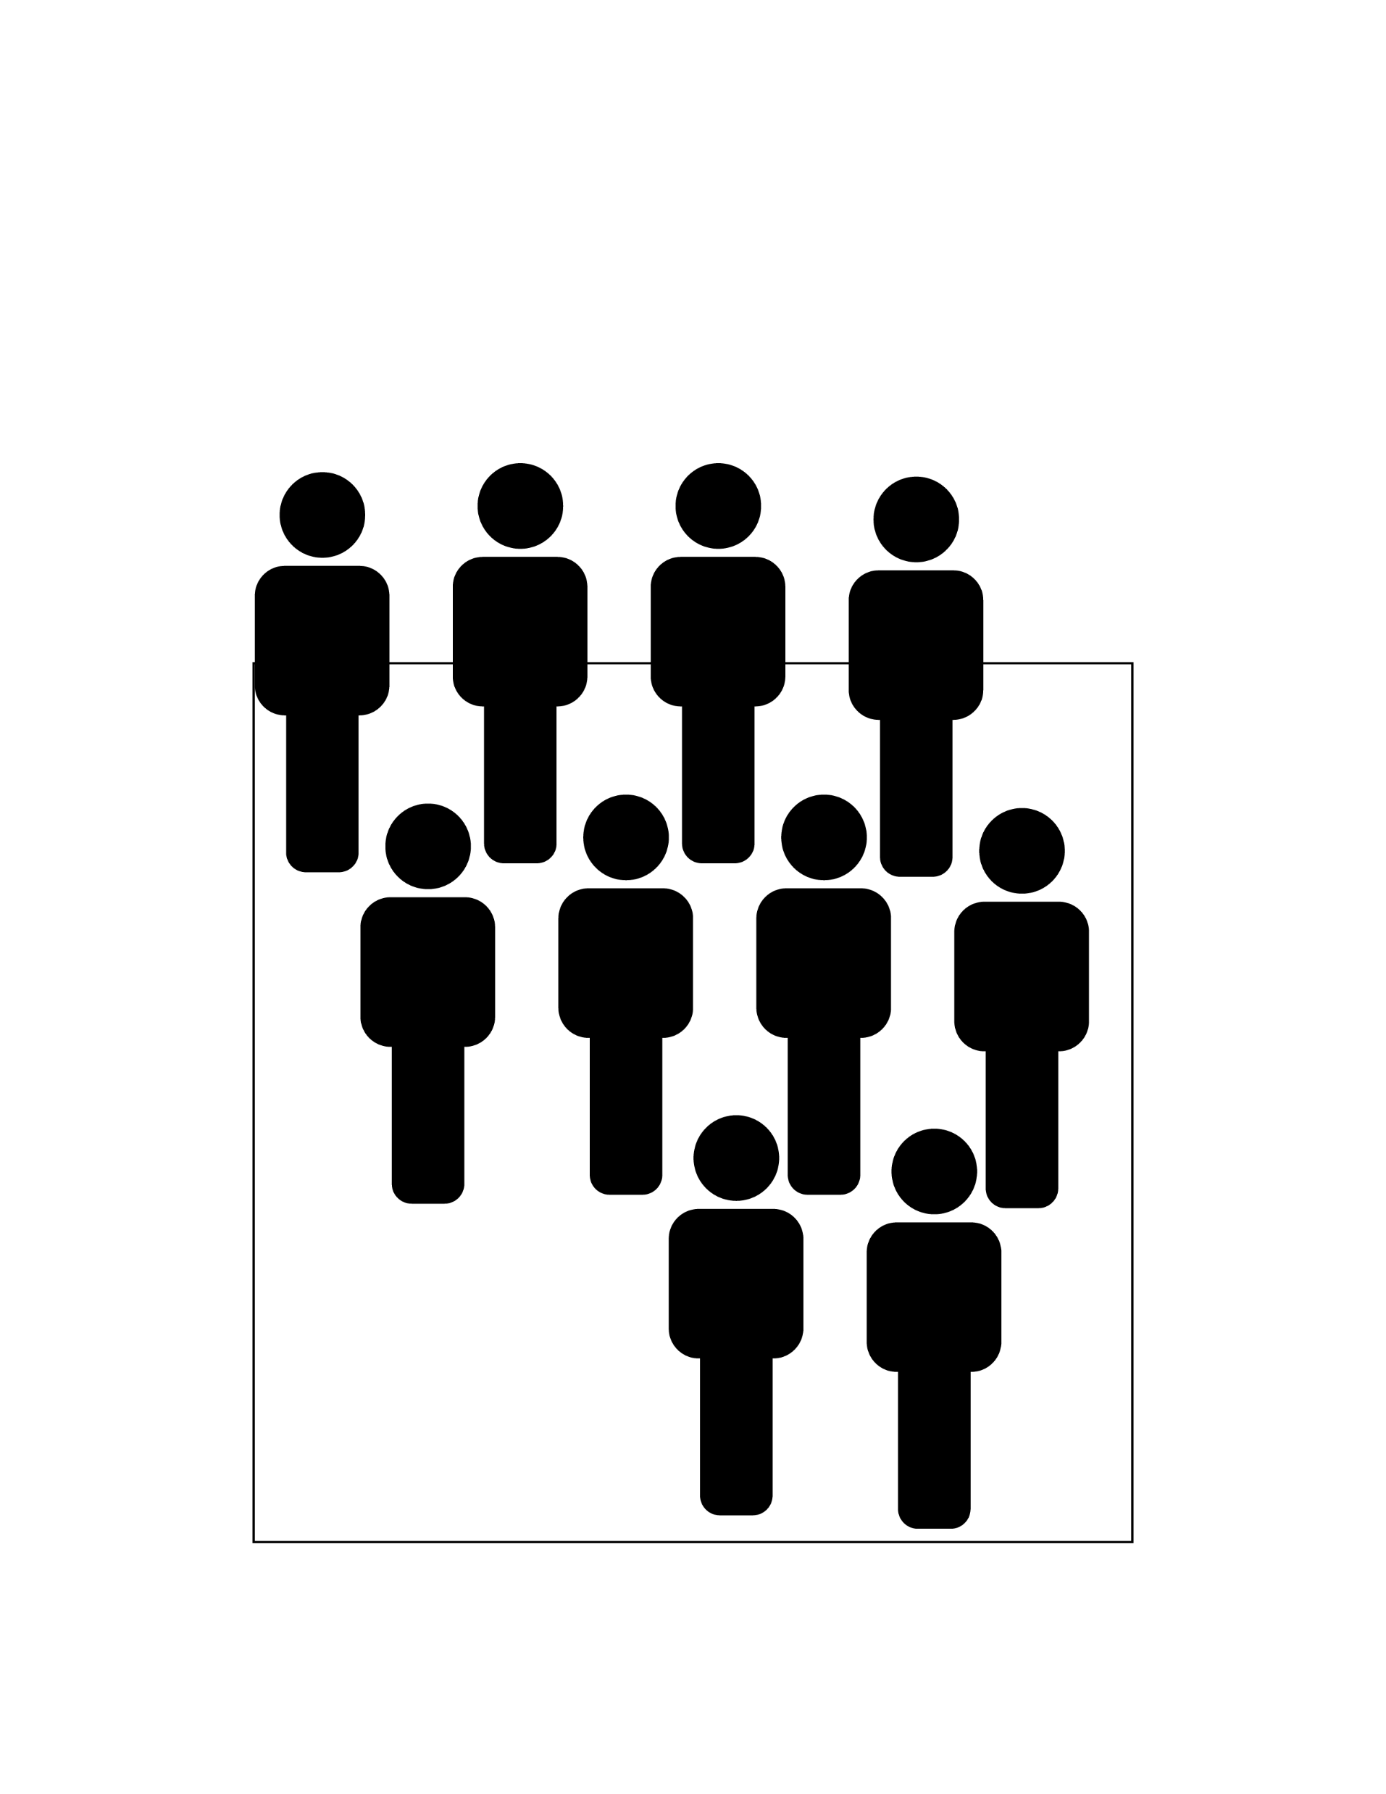


Manufacturing creates more and higher-paying jobs and more tax revenue per project than warehousing and logistics.
Manufacturing:
30% more jobs per project
68% higher wages
5% more investment per project
Average Wages in Kenton County
All Industry Sectors: $65,596
Manufacturing
$75,603
Warehousing
$44,910
Manufacturing
Warehousing

Slide 8


Currently, warehousing and logistics are squeezing manufacturing out of Kenton County.
Manufacturing Facility
MANUFACTURING
Average Size 190,000 sq. ft.
90
The average warehouse size is nearly double the size of the average manufacturing facility size.
Truck traffic from warehouse facilities is more than twice truck traffic from manufacturing facilities.
Average 90 Trucks Daily
Warehouse Facility
WAREHOUSE
Average Size 330,000 sq. ft.
210
Average 210 Trucks Daily

Slide 9
Goal: Create readily available sites for development to reduce uncertainty for high-tech manufacturing prospects, increasing the chances of attracting them to Kenton County.

Slide 10
Table discussions

Slide 11
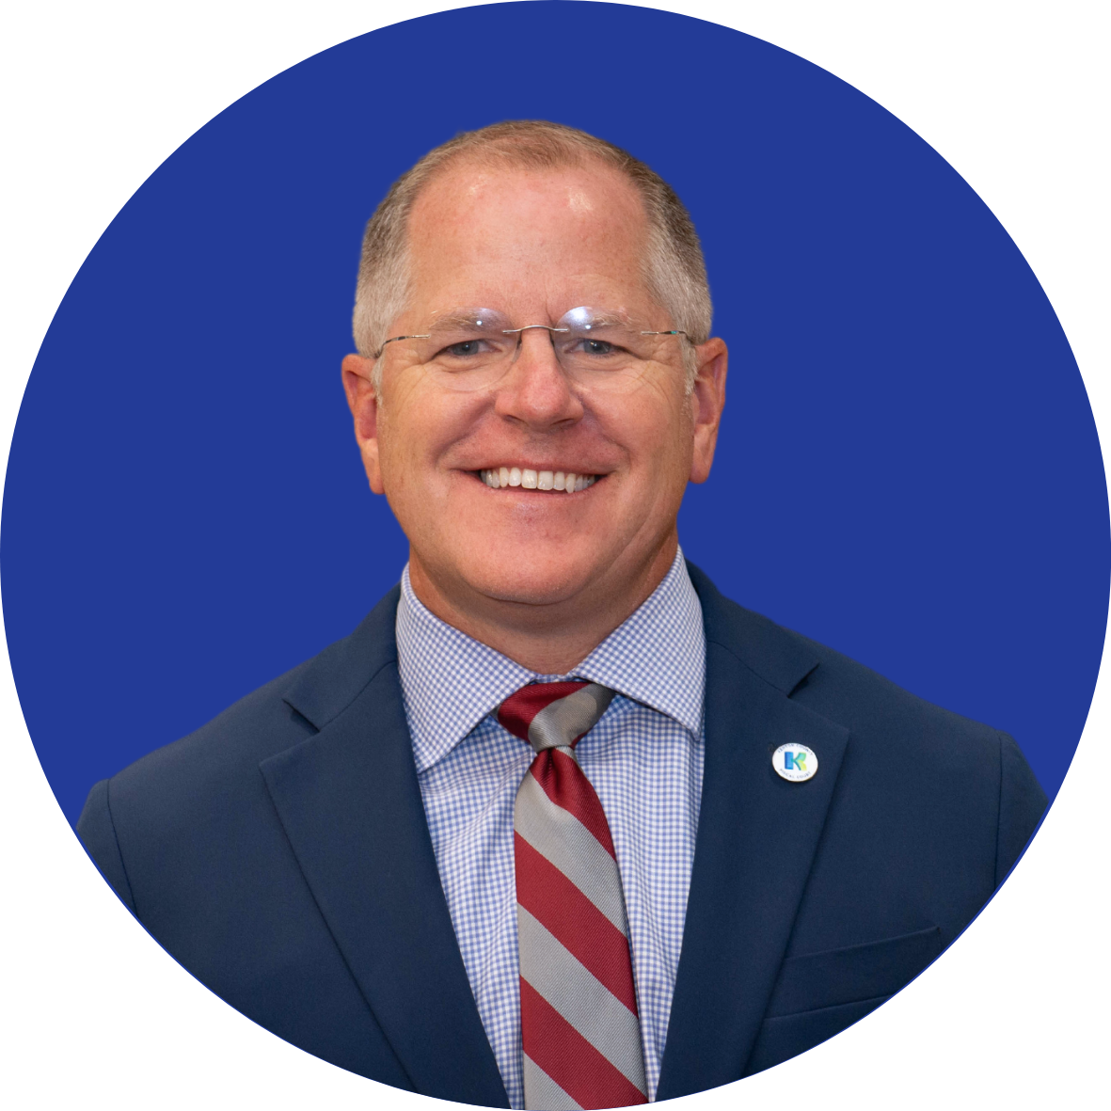


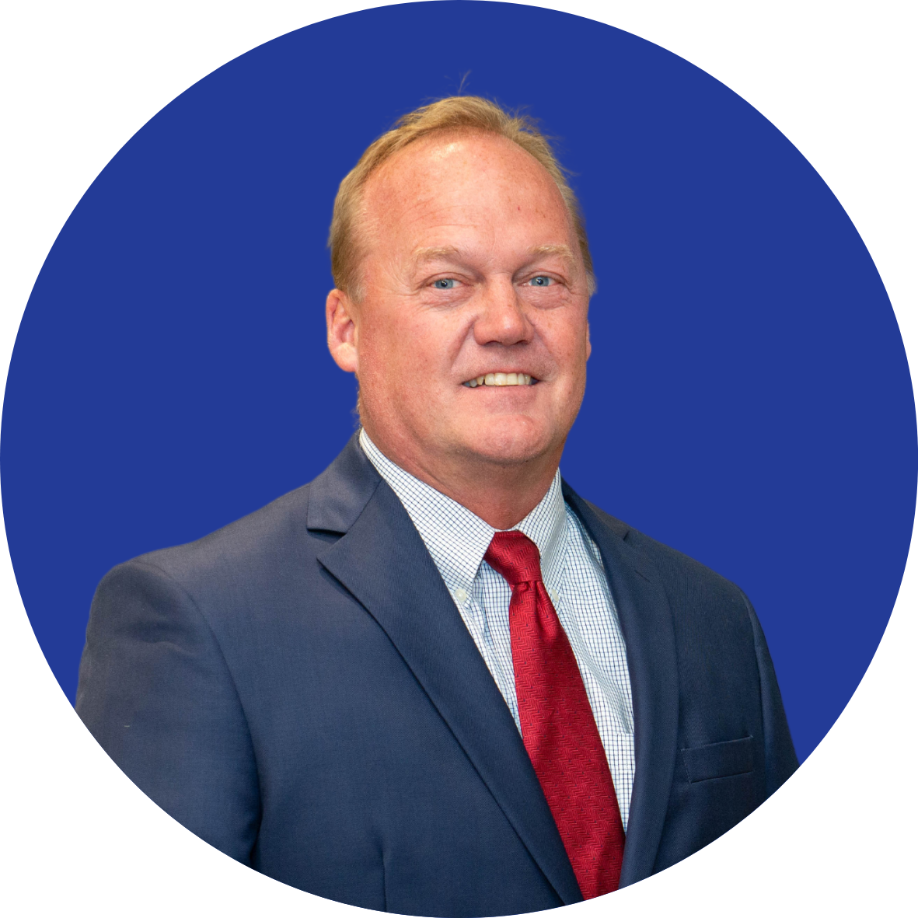
Judge/Executive Kris Knochelmann
Phone: (859) 835-1500
Email: kris.knochelmann@kentoncounty.org
Commissioner Beth Sewell - District 1
Phone: (859) 392-1400
Email: beth.sewell@kentoncounty.org
Contact us
Commissioner Dr. Jon Draud - District 2
Phone: (859) 392-1400
Email: jon.draud@kentoncounty.org
Commissioner Joe Nienaber Jr. - District 3
Phone: (859) 392-1400
Email: joe.nienaber@kentoncounty.org

Slide 12
What’s next?

